Slide 1

APPLE STOCK PREDICTION
Group Member
VIJVAL vEMULA
Tyler Brenner
Priyanka Patil
Prof : Milad Toutounchian
Subject : DSCI631

Slide 2
Content
Knowing dataset
Exploratory Data Analysis
Proposed Machine Learning Models
Linear Regression Model
Random forest Classifier
Long Short-Term Memory Algorithm
Comparative Analysis of Algorithmic Results
Conclusion
Limitation
Future work

Slide 3
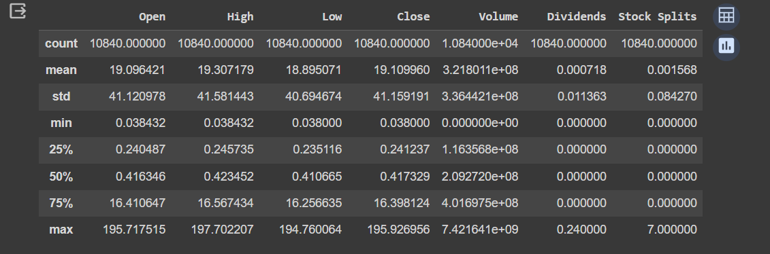
Knowing dataset
10840 rows and 7 columns
No missing value in dataset
Analyzed historical Apple stock prices from 1980 to till date
Source Yahoo finance API.https://finance.yahoo.com/quote/AAPL/history?p=AAPL

Slide 4
Exploratory data analysis
Analyzed historical Apple stock prices from 1980 to till date
Gained insights into long term trends, volatility, patterns
Identified events that impacted stock price
Understand relationship between Apple stock and broader market
Visualized Apple stock price over time using charts
Detected seasonal patterns or recurring trends
Derived key insights to inform trading, modeling, and predictions

Slide 5
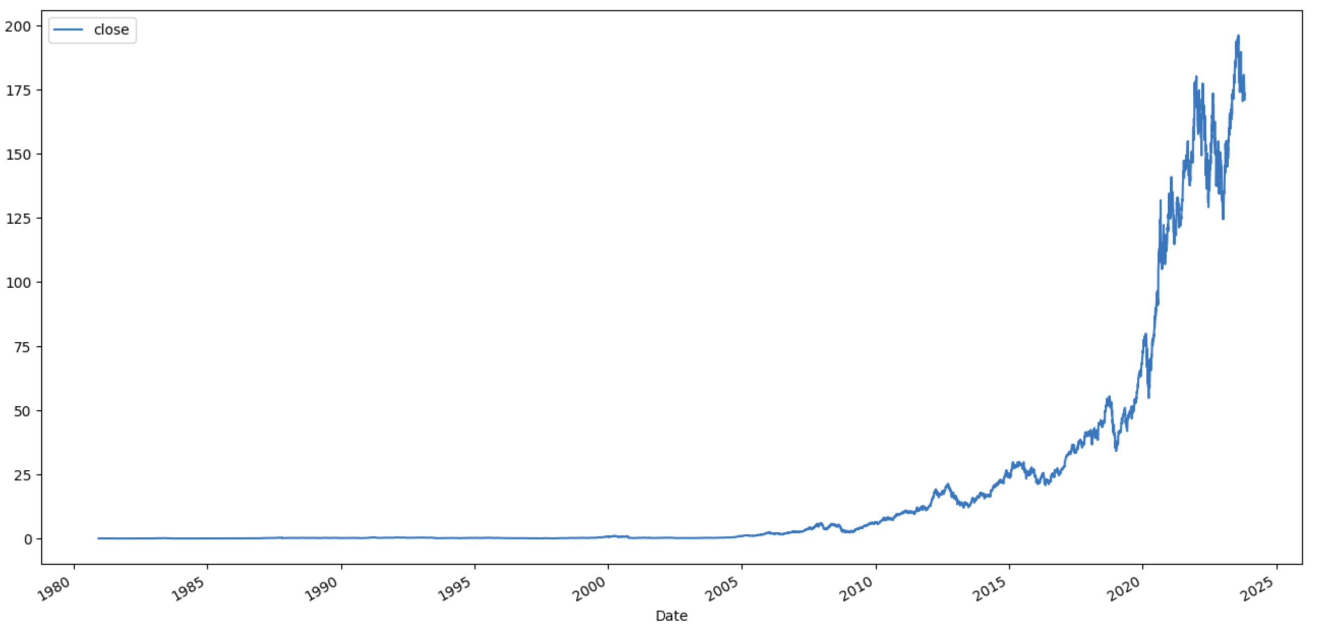
Apple stock Prices over the time

Slide 6
PROPOSED MACHINE LEARNING MODELS
Selection of Linear Regression, Random forest classifier and Long Short-Term Memory algorithm.
We used the Linear Regression to split the data into test and training sets and then trained the model with the training set to predict the stock's future price.
For Random Forest classifier we have created a binary target variable that tells whether tomorrow’s stock price will be greater than or less than today's closing price and this is the hypothesis of our second model.
For LSTM, we built a model that has neural network layers. So, the main aim of this model is to predict tomorrow’s stock prices using past 60 days data of the stock price

Slide 7
Linear Regression algorithm
Linear regression is a simple and easy-to-understand algorithm. It's based on the assumption that there is a linear relationship between the input features and the target variable. In the context of stock prediction, simplicity can be an advantage, especially when dealing with a small to moderate amount of data.
Below are metrics of Linear regression model
Root Mean Squared Error (RMSE): The RMSE is a measure of the average magnitude of the errors between predicted and actual values. In your case, an RMSE of approximately 1.076635451325561e-11 indicates that the model's predictions are very far to the actual values.
Mean Absolute Error (MAE): The MAE is another measure of the average magnitude of errors. A MAE of approximately 7.2548110245533774e-12 reinforces the idea that the model's predictions are not too accurate.

Slide 8
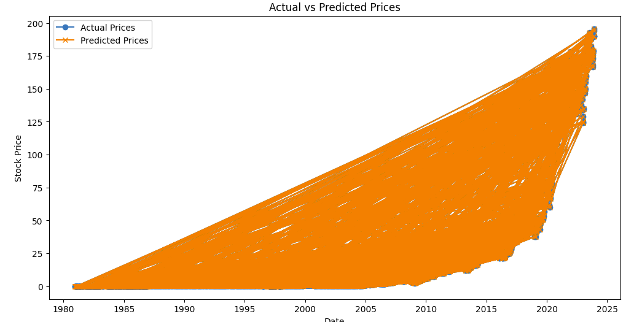
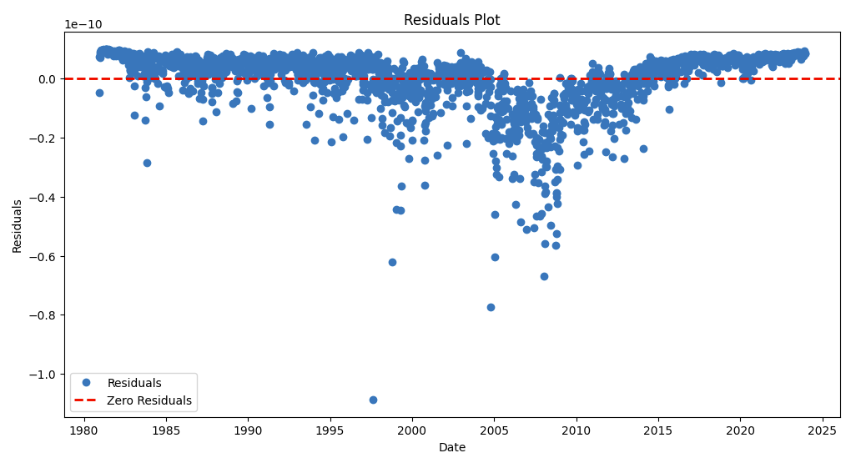

Slide 9
Random forest Classifier Algorithm
Random Forest provides a measure of feature importance, aiding in identifying key factors influencing stock movements.
In the dataset we created new column called "tomorrow". The values of this column is the values of the "close" column. But with the shift of -1.
After this we have created another column called "target" column. This is a binary valued column with values 0 and 1.
0 indicates "tomorrow" column < "close" column
1 indicates "tomorrow" column > "close" column
Our aim is to predict target column.

Slide 10
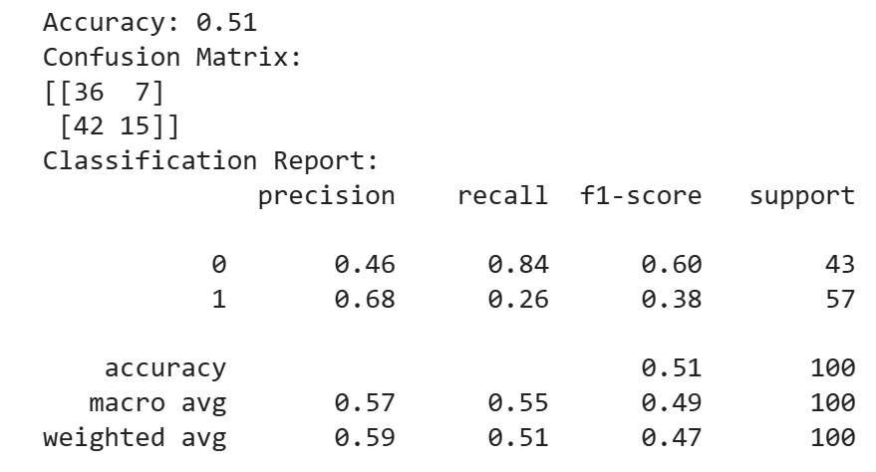
continued
The model's accuracy is around 51%, which indicates that the model is making correct predictions for slightly more than half of the instances.
There appears to be an imbalance in the dataset, as indicated by the differences in precision, recall, and F1-score between the two classes. Class 1 (perhaps indicating a particular stock movement) has lower precision, recall, and F1-score compared to Class 0.
The precision for Class 1 is higher, suggesting that when the model predicts an increase in stock prices, it is correct more often. However, the recall is low, indicating that the model misses a significant number of instances where stock prices actually increase.

Slide 11
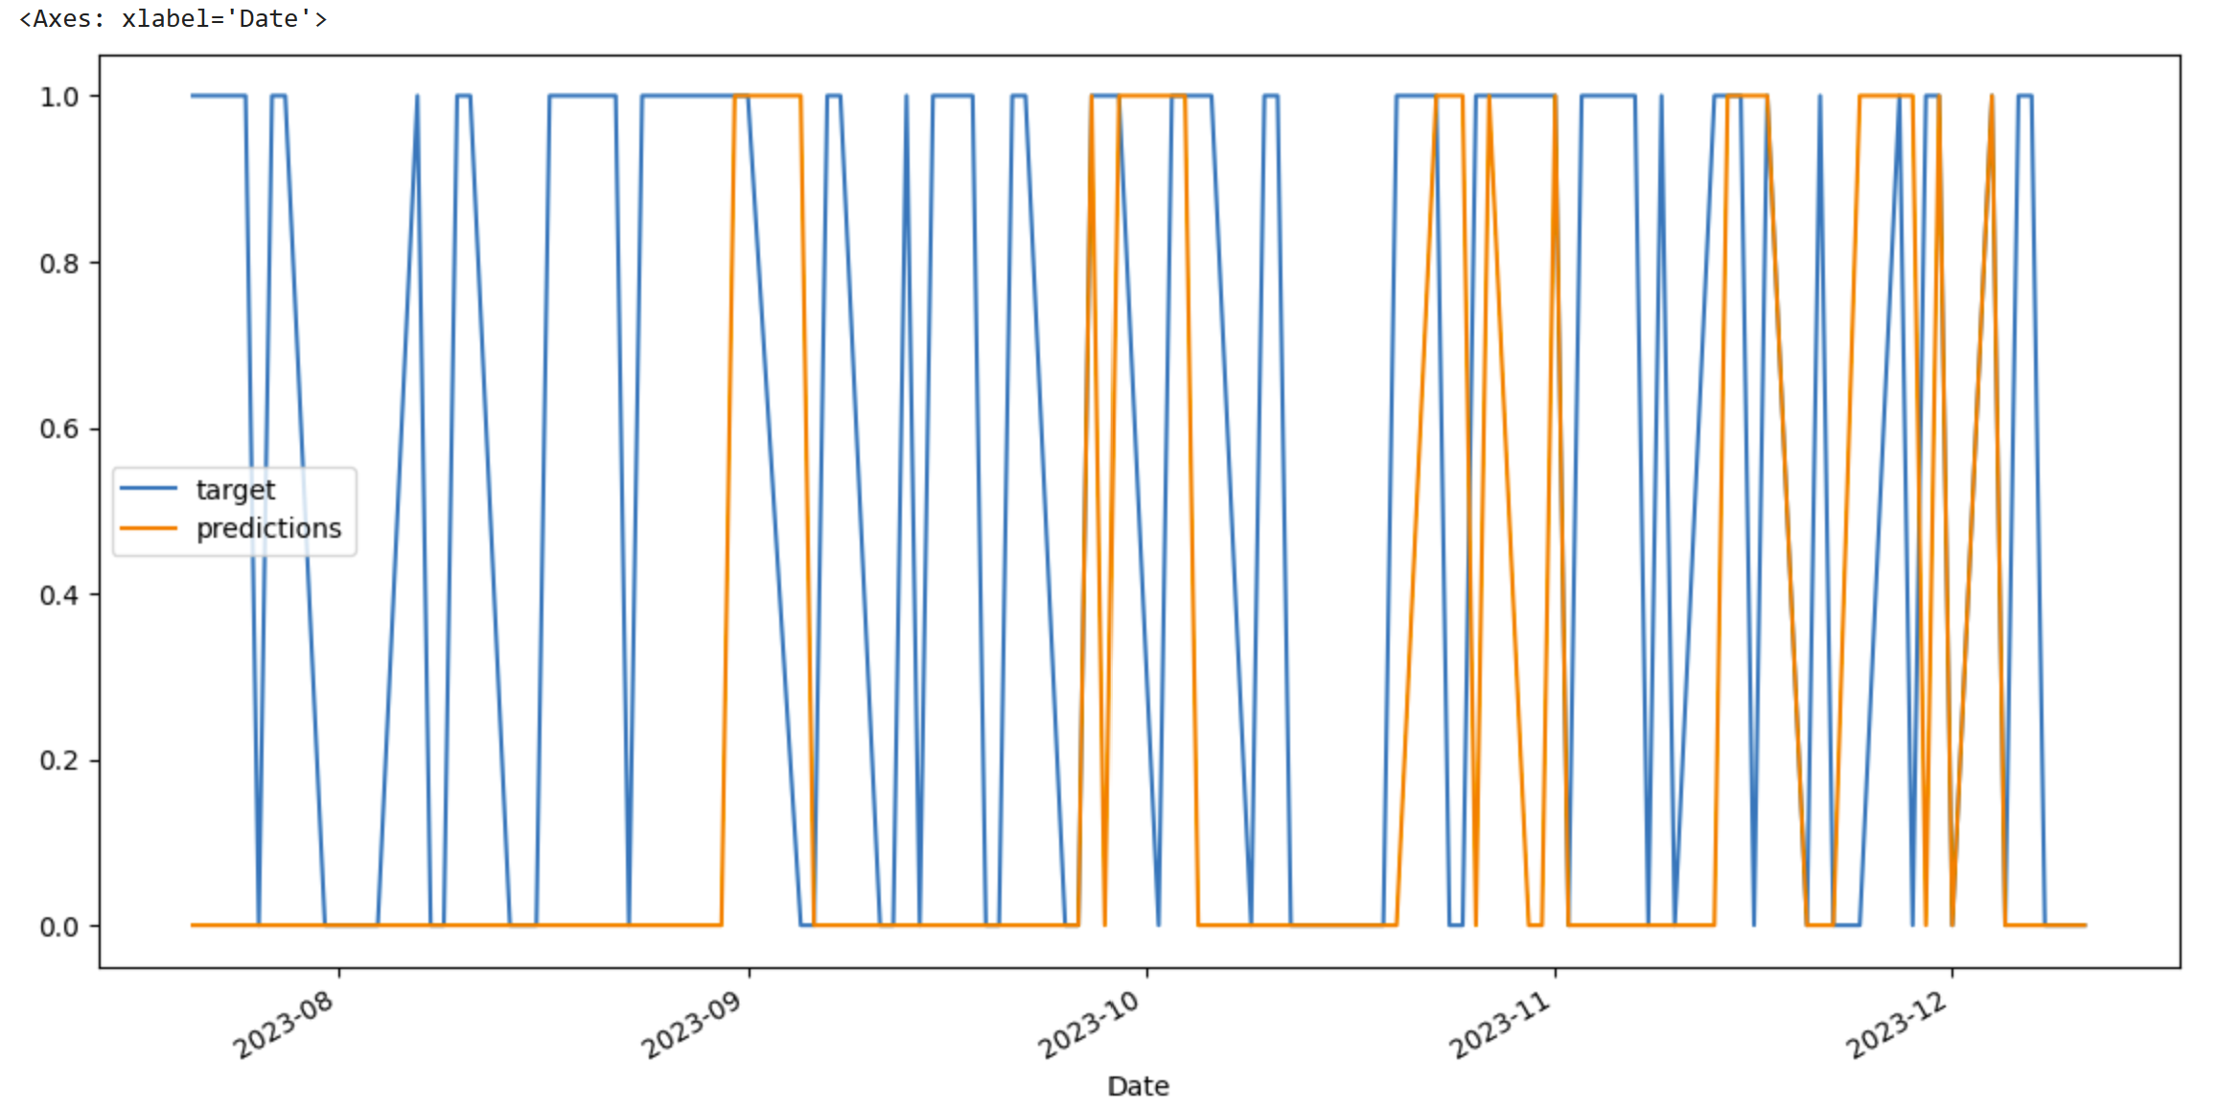

Slide 12
Long Short-Term Memory algorithm
In LSTM we have use sequential neural network model.
We used the dense and LSTM neural network layers. The working of the model takes 60 consecutive closed price values to predict the closing price in 61st day.
The model architecture is a two-layer LSTM network followed by two Dense layers. The LSTM layers are designed to handle sequential data, making this architecture suitable for tasks like time-series prediction. Also, we have truncated the data from 2012 to till date.
The Dense layers at the end contribute to the final output. The number of units in each layer and the choice of activation functions can be further adjusted based on the specific requirements and characteristics of your data.
Since the model will take value from 0 to 1 we have scaled the train and test values into this range using min max scaler even predictions are in these range only. So, we performed an inverse transform bring the predictions back to their original scale.

Slide 13
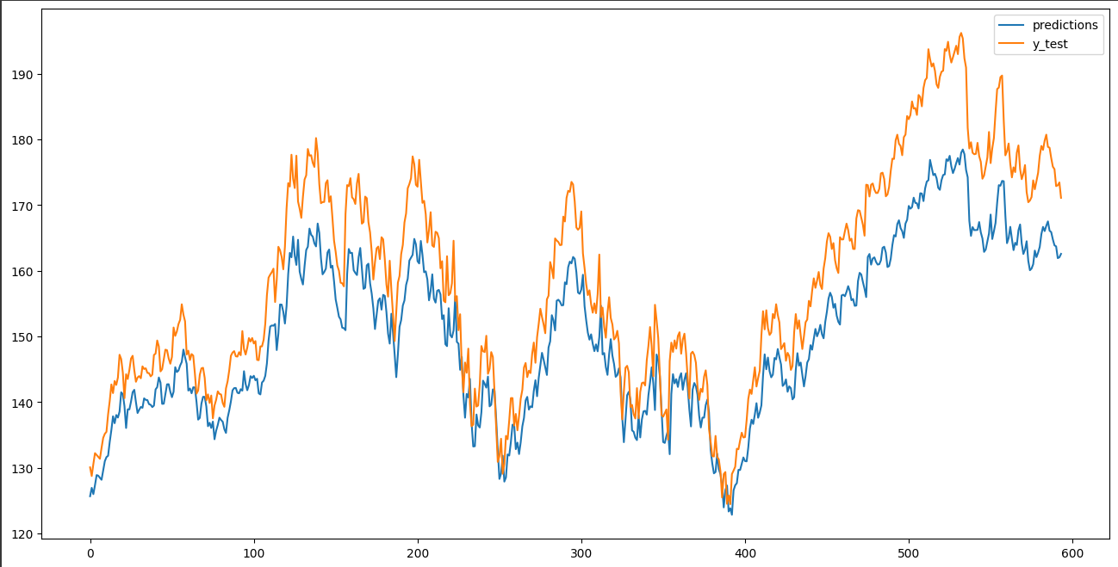
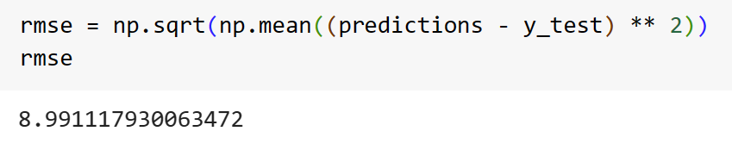
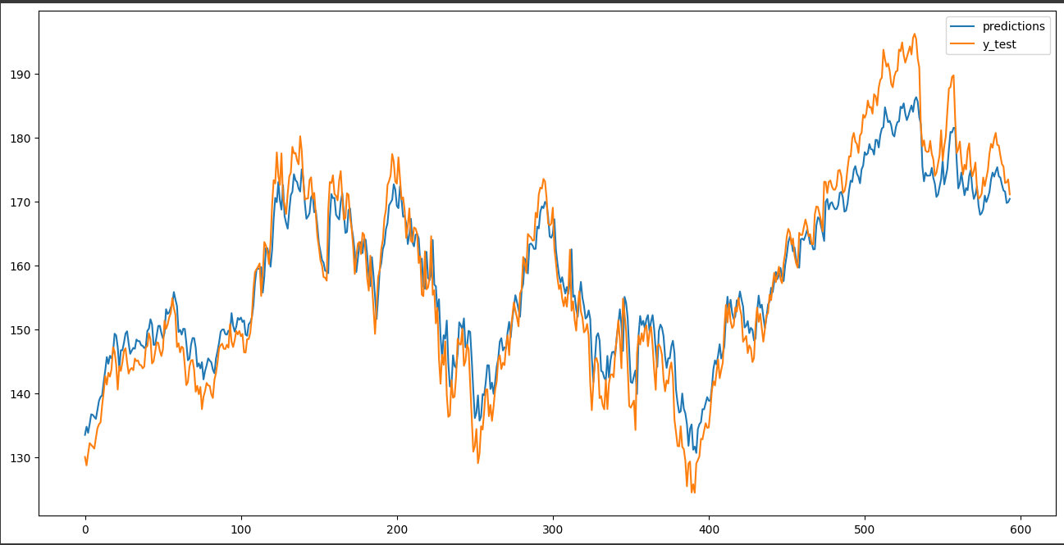
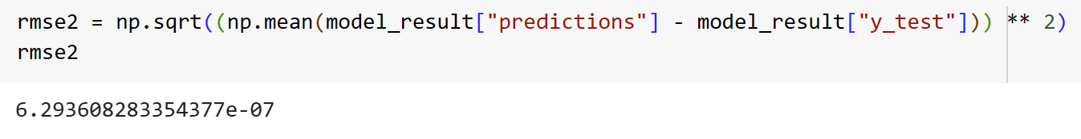
Before
After

Slide 14
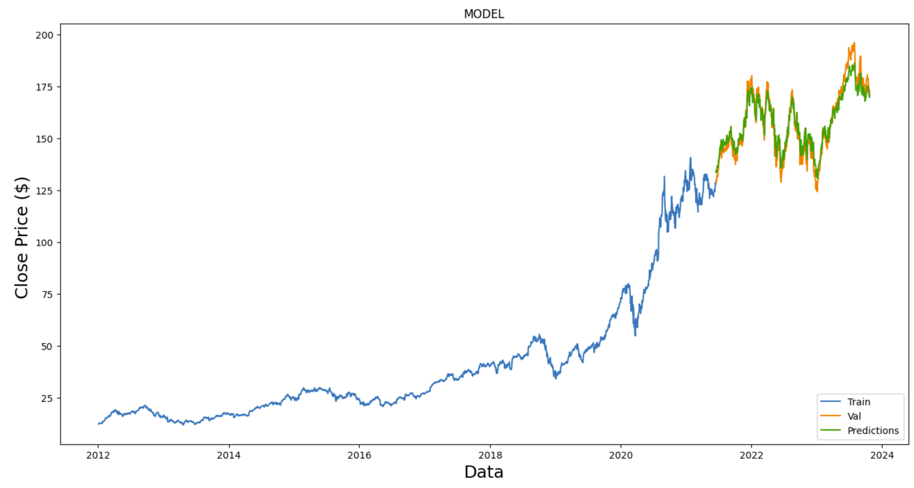

Slide 15
Comparative Analysis of Algorithmic Results
Linear Regression:
Strengths: High R-squared (0.9) indicates a good fit. However, the RMSE and MAE values suggest a substantial error in predicting stock prices.
Concerns: The high error metrics (RMSE and MAE) might indicate limitations in capturing the underlying patterns in the data.
Random Forest Classifier:
Strengths: While the accuracy is 0.51, indicating performance slightly better than random chance, the precision for class 1 (stock price increase) is relatively high at 0.68.
Concerns: The model appears to struggle with recall for class 1, indicating a high number of false negatives.
LSTM:
Strengths: Extremely low RMSE (6.29e-07) indicates that the LSTM model is making very accurate predictions, at least on the provided data.
Concerns: The extremely low RMSE may be a signal of overfitting. It's crucial to assess the model's performance on new, unseen data to ensure generalization.

Slide 16
Conclusion
Linear regression model is not accurate, and it needs extensive hyper tuning of parameters
Random forest classifier is comparatively good performer than Linear regression model.
LSTM is giving more precise results if trained well.

Slide 17
Limitation
Financial markets, including the stock market, are influenced by a myriad of factors, including economic conditions, global events, political developments, and investor sentiment. The inherent volatility and unpredictability of these factors make accurate predictions challenging.
This is just an initial idea please do not use for actual prediction purpose.
Compliance with financial regulations and ethical considerations is crucial in financial modeling. Predictions should be made transparently and ethically, with an awareness of potential legal implications.

Slide 18
Future work
Design a system to handle real-time data updates and predictions. This is crucial for applications that require up-to-the-minute information for decision-making.
Build ensemble models that combine predictions from multiple models, such as a combination of LSTM networks, random forests, or gradient boosting algorithms. Ensemble methods often lead to improved generalization and robustness.
Consider more complex deep learning architectures, such as attention mechanisms or transformer-based models, which have shown success in sequential data tasks. These architectures may capture intricate dependencies in time-series data.
Implement a robust evaluation strategy that includes periodic model retraining and assessment of model performance on recent data. Financial markets evolve, and model effectiveness may change over time.

Slide 19
Thank You

